Slide 1

PRODUCT SALES ANALYSIS – PHASE 2
Sales evaluation is reviewing your sales records to become aware of tendencies and patterns. income data permit you to make higher selections approximately your product, pricing, promotions, inventory, patron wishes other factors of your business. sales evaluation may be as simple as reviewing your income figures often.

Slide 2

Data Extraction: Unleashing the Power of Information
Information Extract is the exercise of choosing data from one or more resources for the purpose of storing it, transforming it, integrating it and analyzing it for business intelligence or superior analytics. facts extracts take all or a part of records from a supply, and is the first step inside the procedure referred to as ETL: Extract, rework and cargo for turning supply records into relevant, correct evaluation-prepared statistics merchandise that may be used to create actionable insights and analytics.

Slide 3


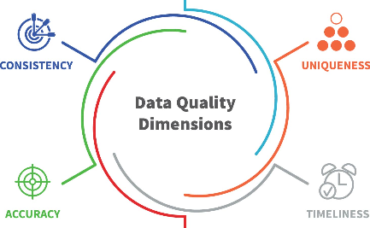
The Art of Extracting Valuable Data
Manual Extraction
Automated Extraction
Data Quality Challenges
Learn in what way or manner to extract dossier manually, employing human knowledge to define and extract valuable judgments from differing sources.
Unleash the capacity of automation and investigate contemporary technologies that help adept and accurate dossier distillation.
Discover the prevalent hazards of data feature that frequently arise all the while the ancestry process and discover how to overcome ruling class.

Slide 4
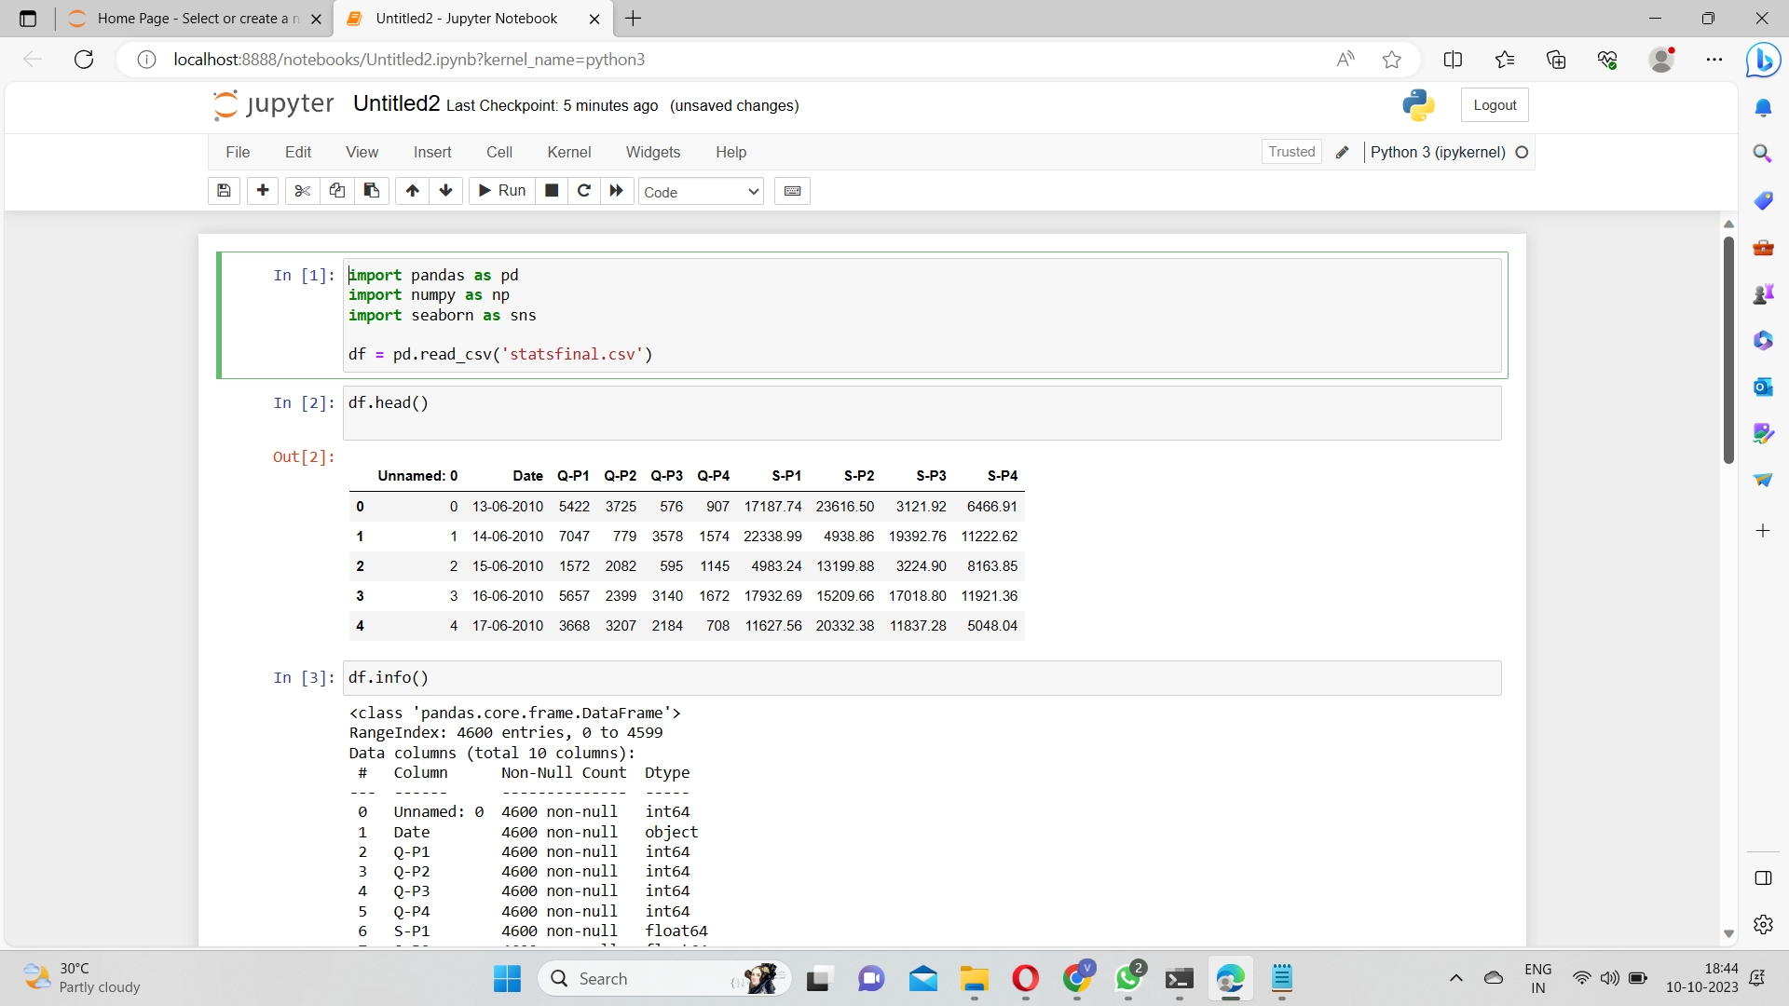
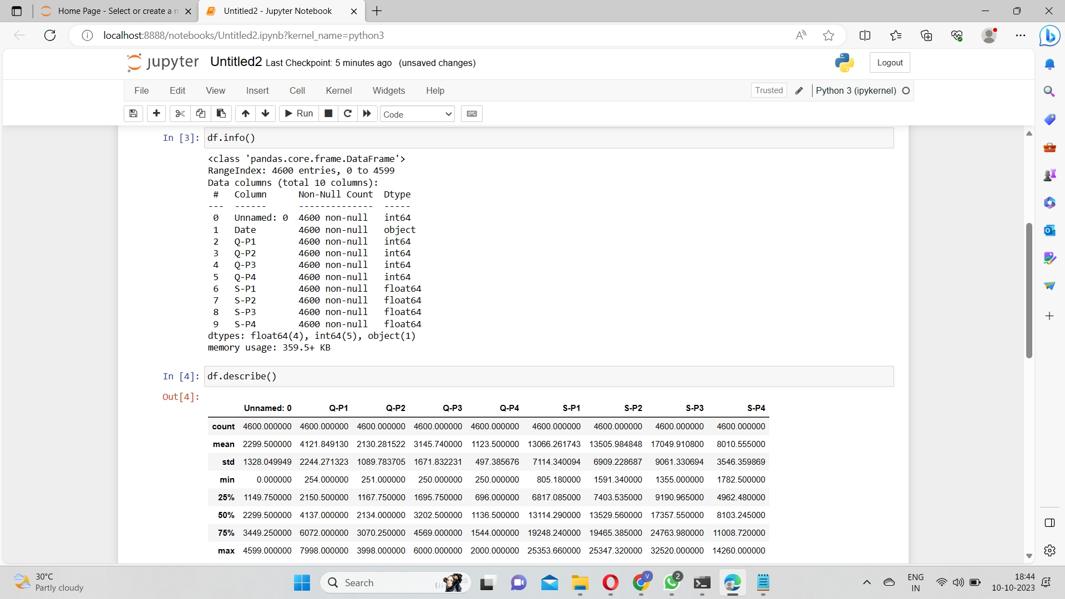
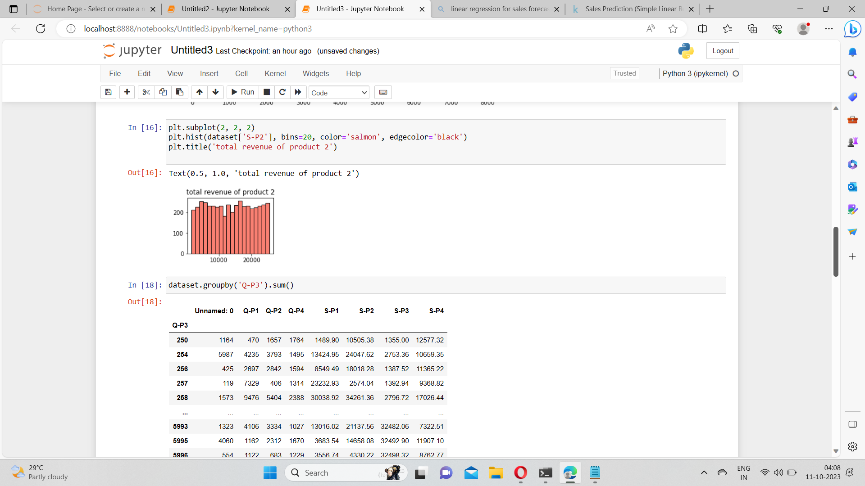
Data Extraction
Import Libraries
Data extraction
Data Visualization

Slide 5
In a Jupyter Notebook, dossier origin is typically acted utilizing Python book repositories like pandas. First, you significance the necessary atheneums and load your dossier beginning, in the way that a CSV file using pandas. After stowing the dossier, you investigate allure structure and content utilizing arrangements like `head()`, `information()`, and `describe()`. To extract particular dossier, you can administer dribbling and indexing operations. You can before resolve and dream up the dossier using athenaeums like matplotlib or seaborn. Finally, it’s critical to document your work and claim law organization for clearness and reproducibility.

Slide 6
You can found dossier visualizations in a Jupyter Notebook utilizing atheneums like Matplotlib, Seaborn, or Plotly. Import the requested atheneum, delineate your dossier, and design visualizations, to a degree line plots, strew plots, or bar charts, accompanying equivalent labels and titles for clarity. Use appearance commands like `%matplotlib inline` or `%matplotlib pad` to display the plots inside the pad. These visualizations are essential for investigating and corresponding dossier flows and patterns in a more comprehensible and charming approach.

Slide 7
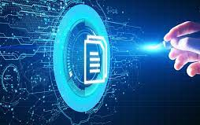
The Future of Data Extraction
The future of dossier distillation is being formed by the onset of Intelligent Document Processing (IDP), a electronics that is to say transforming the habit businesses handle their dossier. This inclusive guide aims to clear up the future of dossier ancestry, focusing on the function of IDP in streamlining movements, reconstructing adeptness, and forceful business development.In conclusion, IDP is fight reformulate the future of dossier extraction. It offers a hopeful resolution to the challenges of established dossier origin methods, providing trades accompanying a faster, more correct, and economical habit to handle their data. mathematical age.

Slide 8

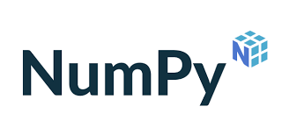

INTRODUCTION TO DATA VISUALIZATION
NumPy, that means "Numerical Python," is a fundamental atheneum in Python for scientific calculating and dossier reasoning. It supplies support for active accompanying large, multi-spatial arrays and forges, in addition to a accumulation of analytical functions to operate on these arrays.
Pandas is an open-beginning Python book repository used for dossier guidance and study. It provides smooth-to-use dossier forms and functions for working accompanying organized dossier, primarily in the form of smooth dossier, in the way that spreadsheets or SQL tables.
Matplotlib is a standard Python book repository for creating motionless, lively, and mutual visualizations in a off-course range of formats. It is frequently secondhand for dossier imagination, scientific scheming, and constructing differing types of charts and graphs

Slide 9
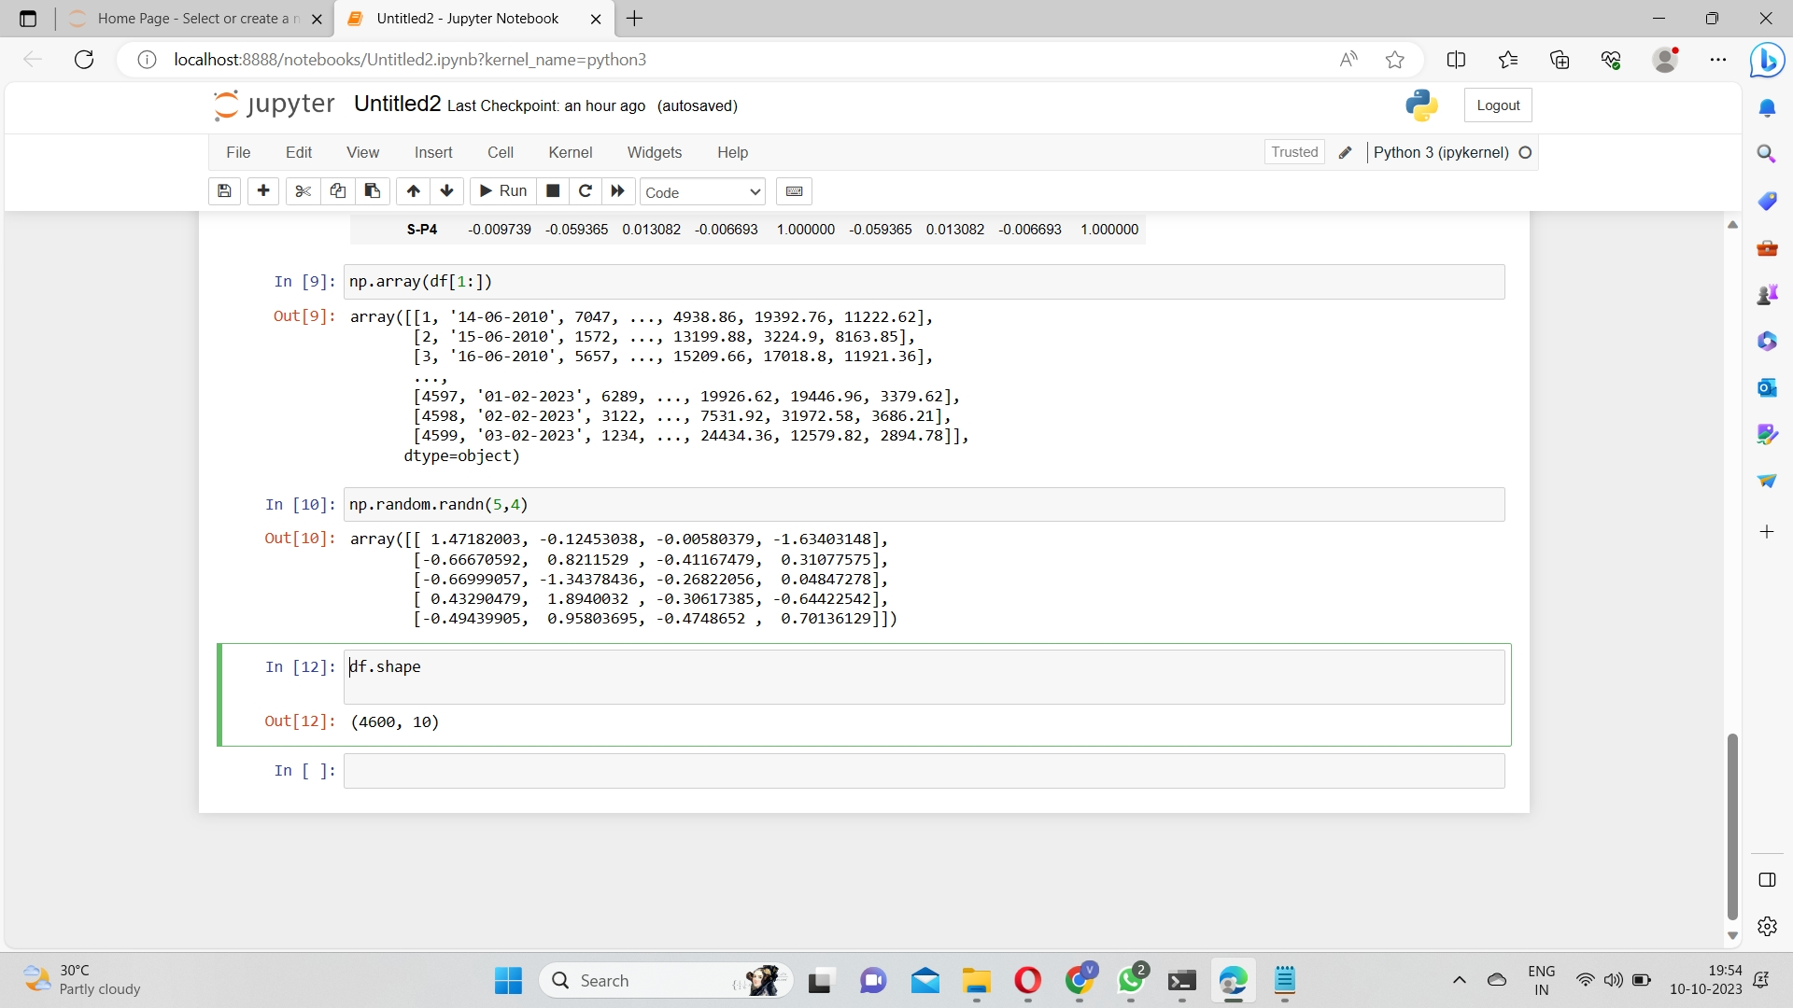
Numpy
Data Loading: NumPy sexually transmitted disease in translation and management datasets from various file plans.
Data Preparation: It assists in cleansing, normative, and adapting data types.
Data Exploration: NumPy calculates enumerations, disclosing judgments into conveyance dossier.Numerical
Operations: Efficient element-reasonable movements, aggregations, and estimations are surely performed. The above movements are treated in the abutting screenshot.

Slide 10
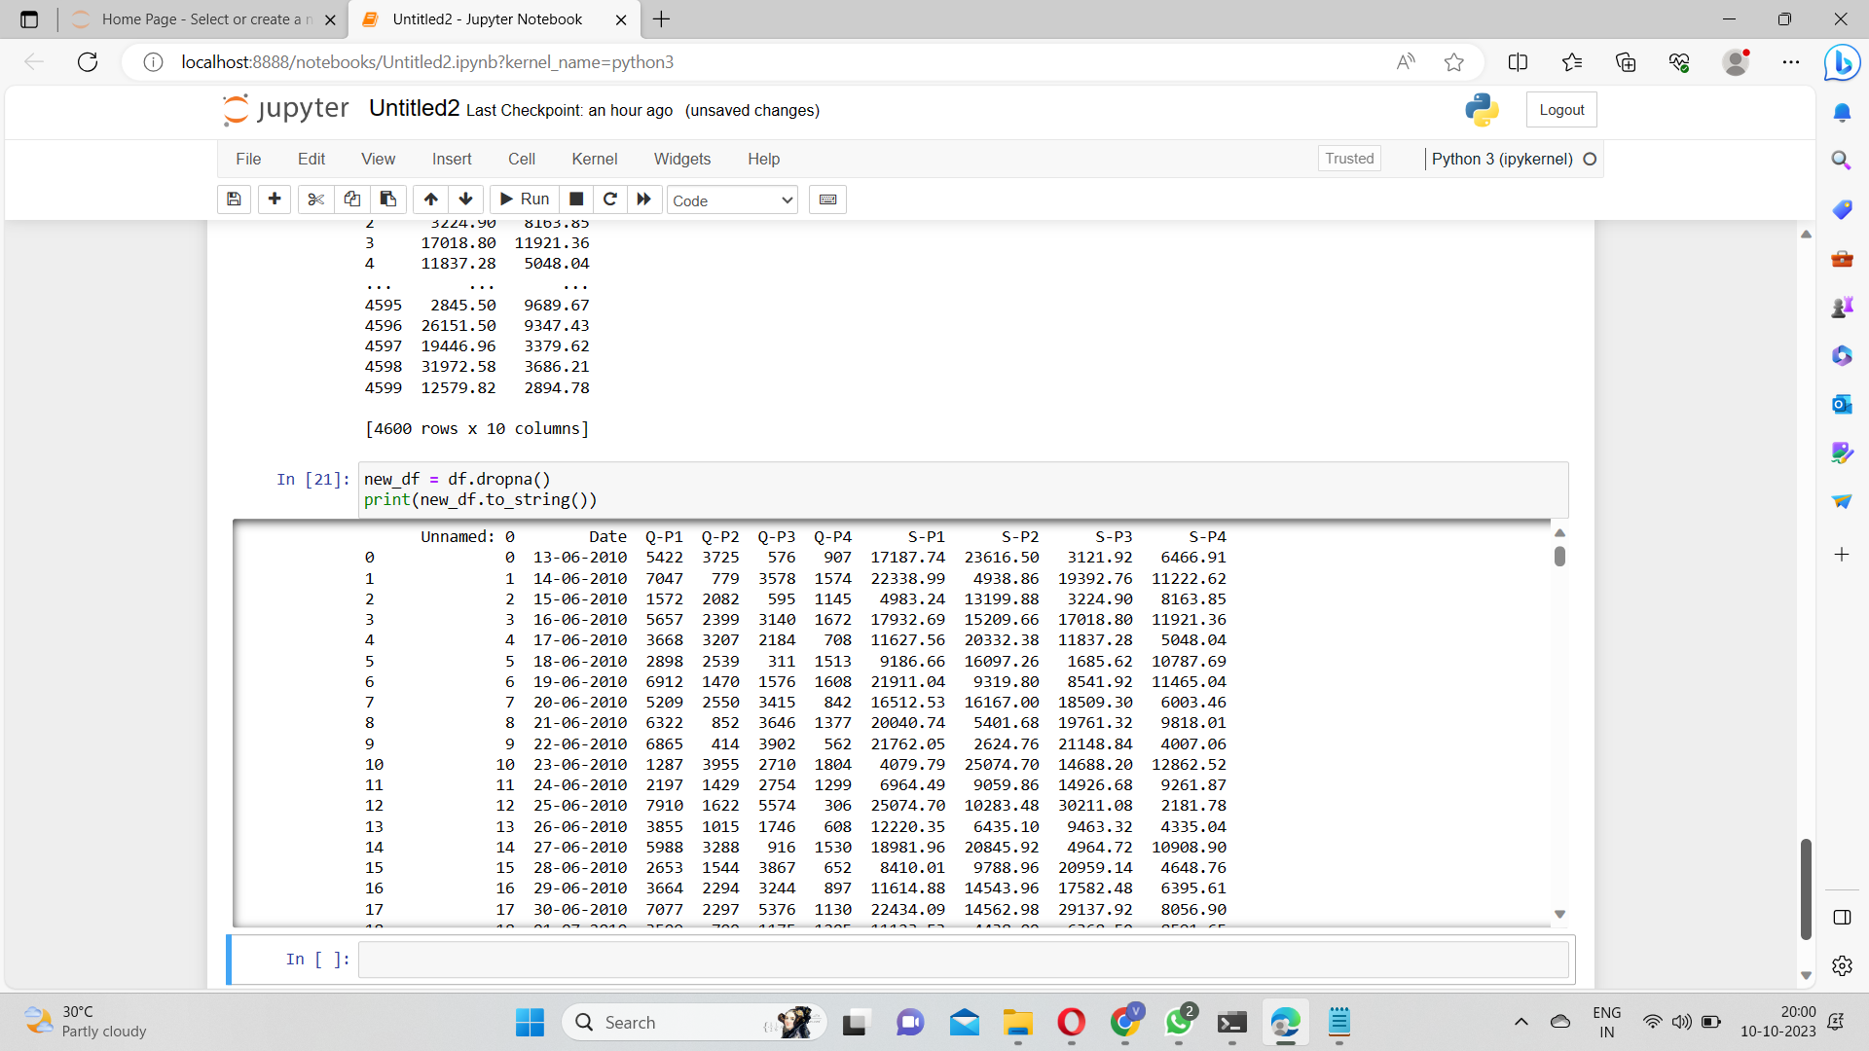
Pandas
Data Import: Pandas reads conveyance datasets from miscellaneous formats in the way that CSV, Excel, SQL databases, or netting sources, into DataFrame makeups.
Data Exploration: Pandas supplies tools for investigating and rehashing data, containing methods for examining fundamental statistics, labeling missing principles, and understanding dossier distributions.
Data Manipulation: Pandas filters, selects, merges, and reshapes dossier capably.
Time Series Analysis: Supports reasoning momentary-related currents in conveyance dossier.

Slide 11
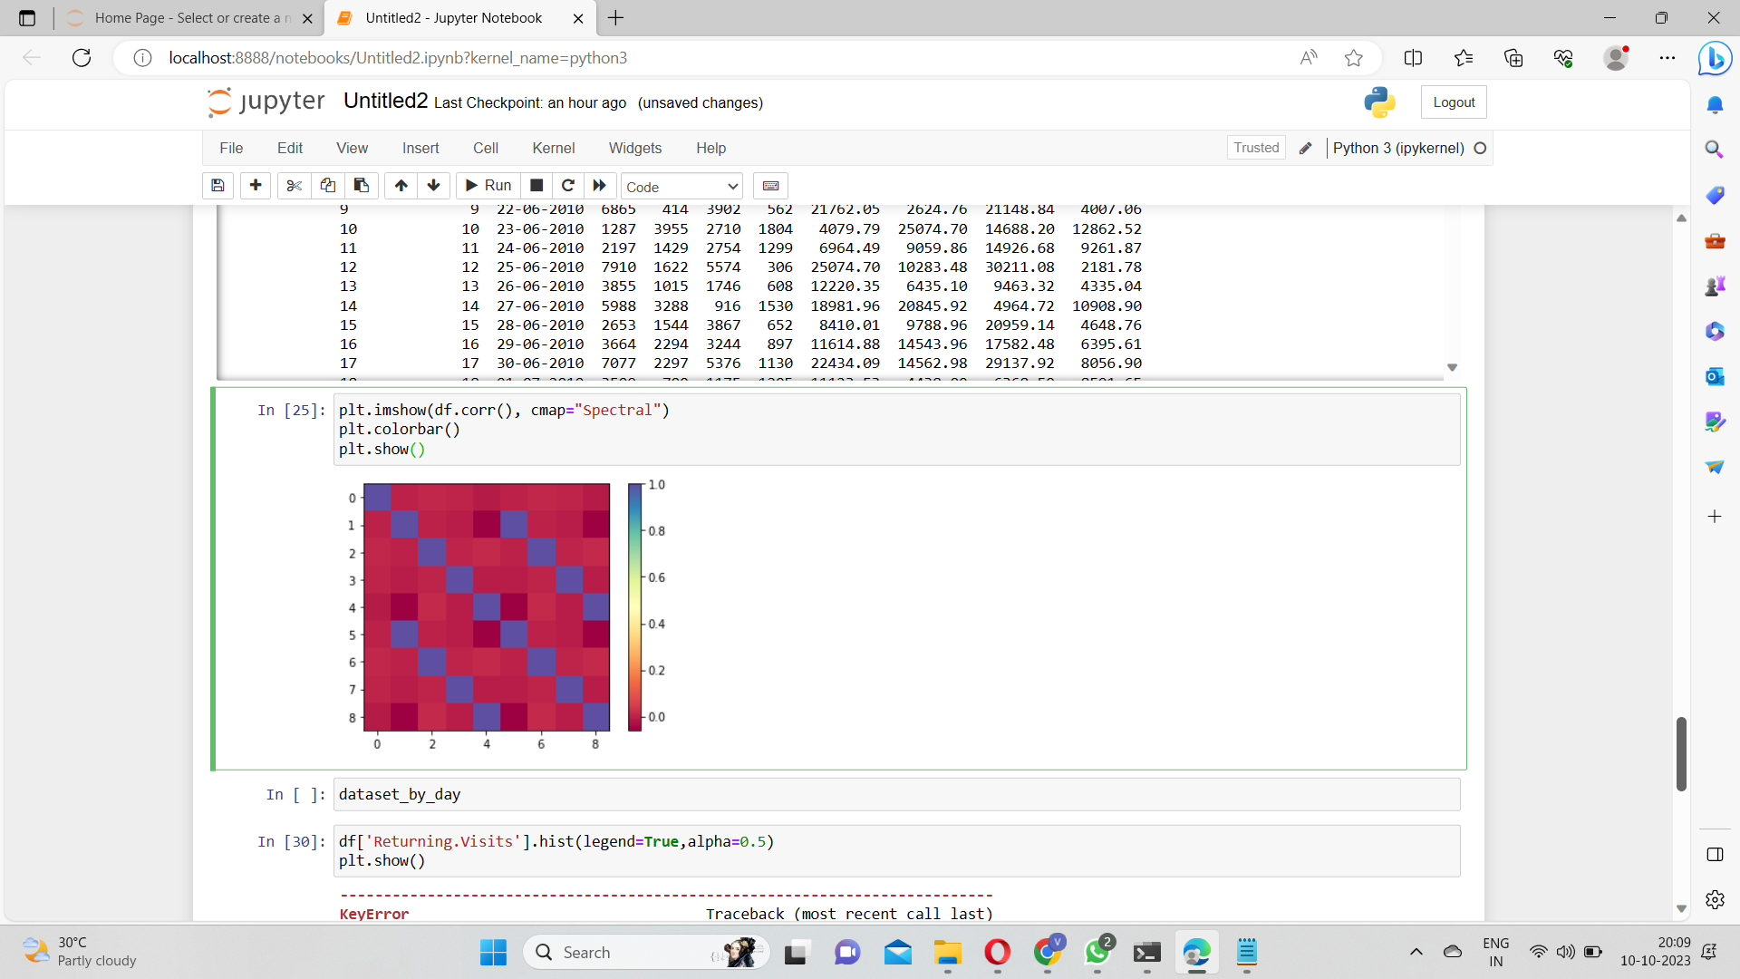
Matplotlib
Data Visualization: Matplotlib forges diverse conveyance dossier visualizations.
Exploratory Data Analysis(EDA): Helps survey dossier, find currents, and discover outliers.
Performance Metrics: Visualizes traffic patterns and effectiveness versification.
Customisation and Interactivity: Offers elasticity and interactivity for productive data likeness.

Slide 12
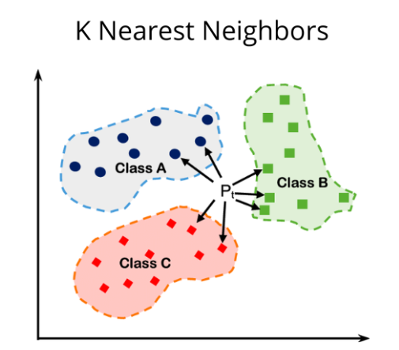
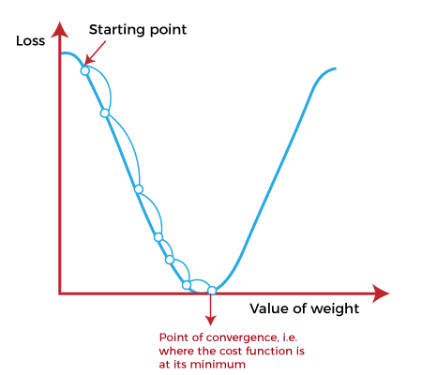
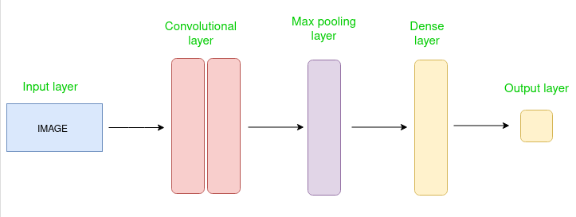
Algorithms
A CNN is a somewhat network construction for deep knowledge algorithms and is expressly secondhand for image acknowledgment and tasks that include the deal with of pel dossier.
K-most forthcoming neighbors (KNN) is a type of directed learning invention secondhand for two together regression and categorization.
Gradient assault is an repetitive growth invention for judgment the local minimum of a function. To find the local minimum of a function utilizing slope lowering.

Slide 13
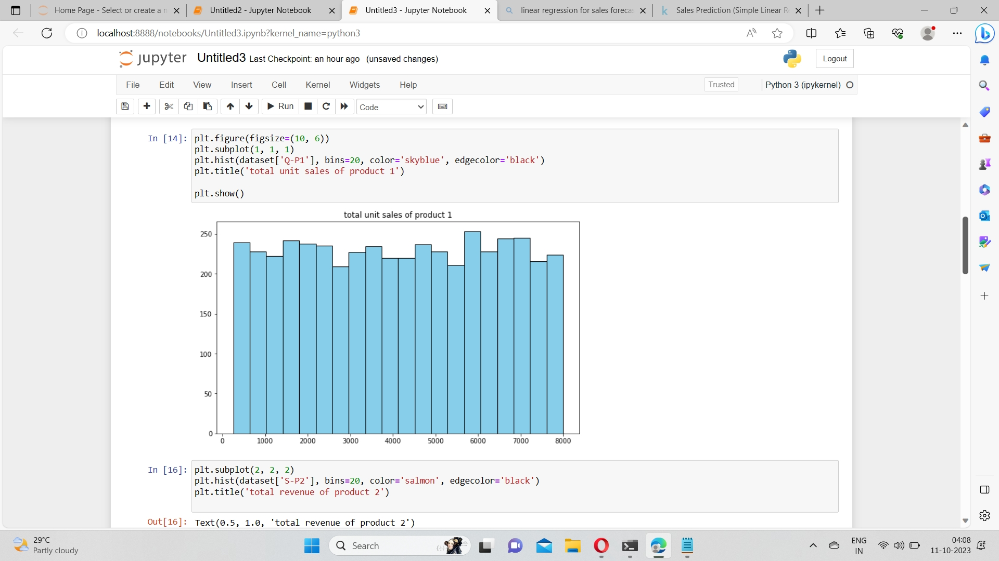
Convolutional Neural Network (CNN)
A Convolutional Neural Network (CNN) is a type of deep education treasure that is specifically suitable for image acknowledgment and dispose of tasks. It is made up of diversified coatings, including convolutional tiers, combining layers, and adequately affiliated tiers.

Slide 14
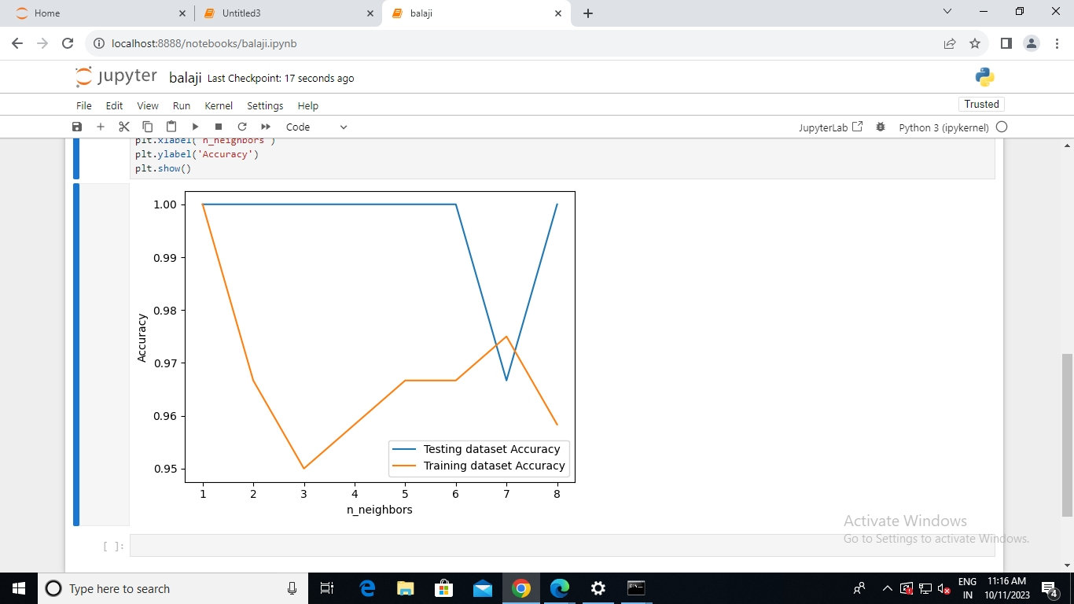
K-Nearest Neighbors (KNN) Algorithm
The k-most forthcoming neighbors invention, also known as KNN or k-NN, is a non-parametric, directed education classifier, that uses closeness to make classifications or forecasts about the arrangement of an individual dossier point. While it maybe used for either reversion or categorization questions, it is typically secondhand as a categorization treasure, occupied off the assumption that identical points maybe raise familiar one another.

Slide 15
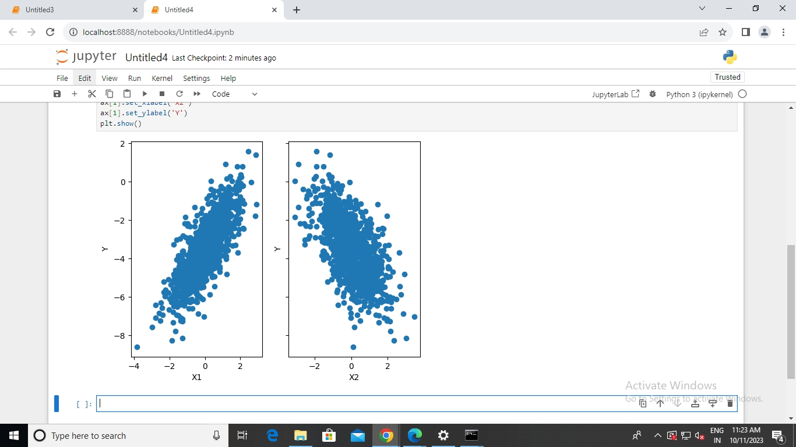
Gradient Descent Algorithm
Gradient deterioration is an growth algorithm that is usually-used to train machine intelligence models and affecting animate nerve organs networks. Training data helps these models discover over occasion, and the cost function inside slope descent particularly acts as a instrument that measures atmospheric pressure, measure allure accuracy accompanying each redundancy of limit revises.

Slide 16

CONCLUSION
In conclusion, the combination of data birth, data visualization, and machine literacy algorithms, including Convolutional Neural Networks( CNN), K- Nearest Neighbors( KNN), and Gradient Descent, offers a important approach to data analysis and prophetic modeling within the Jupyter Tablet terrain. Data birth is the foundational step, where applicable information is collected and preprocessed. Data visualization aids in understanding and presenting complex data patterns and trends, enhancing interpretability. The integration of machine literacy algorithms like CNN for image analysis, KNN for bracket, and grade Descent for optimization empowers data- driven decision- timber. This holistic approach enables data scientists and judges to prize perceptivity, make prophetic models, and make informed opinions, eventually unleashing the eventuality of data for colorful operations, from computer vision to pattern recognition and optimization problems. Jupyter Notebook serves as an excellent platform for seamlessly integrating these factors and fostering collaboration and attestation throughout the data analysis and machine literacy process.

